Slide 1
Unit-3
Feedforward Neural Networks
By: Arjun Saud, Asst. Prof. CDCSIT,TU

Slide 2
Perceptron
The perceptron is the simplest form of a neural network used for the classifying linearly separable patterns. Patterns that lie on opposite sides of a hyperplane are called linearly separable patterns.
Basically, perceptron consists of a single neuron with adjustable synaptic weights and bias. The algorithm used to adjust the free parameters of this neural network first appeared in a learning procedure developed by Rosenblatt (1958, 1962).

Slide 3
Perceptron
Rosenblatt proved that if the patterns (vectors) used to train the perceptron are drawn from two linearly separable classes, then the perceptron algorithm converges and positions the decision surface in the form of a hyperplane between the two classes.
The perceptron built around a single neuron is limited to performing pattern classification with only two classes. By expanding the output layer of the perceptron to include more than one neuron, we may correspondingly perform classification with more than two classes. However, the classes have to be linearly separable for the perceptron to work properly.

Slide 4
Perceptron
Rosenblatt’s perceptron is built around the McCulloch–Pitts model of a neuron.
The summing node of the neural model computes a linear combination of the input. The resulting sum is applied to a hard limit activation function.
The neuron produces an output equal to 1 if the hard limiter input is positive, and -1 if it is negative.

Slide 5
Perceptron
The hard limiter input (or induced local field) of the neuron is.

Slide 6
Perceptron
The goal of the perceptron is to correctly classify the set of externally applied stimuli x1, x2, ..., xm into one of two classes,c1 or c2.The decision rule for the classification is to assign the point represented by the inputs x1, x2, ..., xm to class c1 if the perceptron output y is +1 and to class c2 if it is -1.
In the simplest form of the perceptron, there are two decision regions separated by a hyperplane, which is defined by.

Slide 7
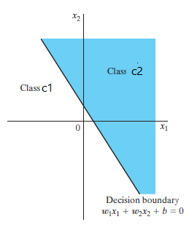
Perceptron

Slide 8
Perceptron
Perceptron can be trained to show behavior of AND function and OR function because both are linearly separable. But, perceptron can not be trained to learn behavior of XOR function because it is not linearly separable.
x₂
x₂
x₂
1
1
1
0
0
1
x₁
x₁
x₁
0
0
0
1
0
1
Fig: AND Function
Fig: XOR Function
Fig: OR Function

Slide 9
Perceptron Convergence Theorem
The Perceptron convergence theorem states that “for any data set which is linearly separable the Perceptron learning rule is guaranteed to find a solution in a finite number of steps, provided that learning rate is small.”
Perceptron learning rule is guaranteed to converge to a weight vector that correctly classifies the examples provided the training examples are linearly separable.
Verification of this convergence theorem is provided in the example of perceptron learning rule.

Slide 10
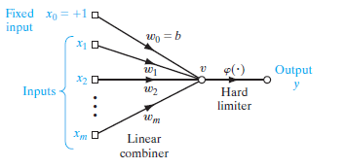
Perceptron Learning Rule
We can derive error correction rule for perceptron. Model of perceptron is given below,
For this model, we can write
Let x=[x_{0,} x_{1,} x_{2,……….} x_{m}] and w=[w_{0,} w_{1,……….} w_{m}]

Slide 11
Perceptron Learning Rule
Now, above equation can be written as:
Let us consider for n^{th} step input vector and weight vector is:
x=[x₀(n),x₁(n),…x_{m}(n)] and w=[w₀(n),w₁(n),…w_{m}(n)]
Now, for n^{th} step, above equation becomes
Suppose and C₁ and C₂ are two classes for which perceptron needs to be trained. So, training set must include sufficient examples from both classes.

Slide 12
Perceptron Learning Rule
Let H₁ and H₂ are set of training examples such that H₁∈C₁ and H₂∈C₂. Thus, Training Set(H)= H₁ ∪ H₂.
We know that perceptron puts data point in class C₁ if output is positive and in class C₂ if output is negative.
This means, data point lies in class C₁ if v>0 and in class C₂ if v≤0. Thus,
For each x∈ H_{1,} and
For each x∈ H_{2,}

Slide 13
Perceptron Learning Rule
Now, we can write weight update rule for n^{th} step as below.

Slide 14
Perceptron Learning Rule
The main theme of above weight change rule is:
Do not change weights in case of correct classification
Increase weights when perceptron output is smaller than actual target
Decrease weights when perceptron output is larger than actual target
Thus, we can represent weight change rule using single equation as below:

Slide 15
Perceptron Learning Rule
Perceptron Learning Algorithm
Initialize all weights and bias to zero
For each training vector s and target t perform steps 3 to 6
Set
Compute output using Hard limiter activation function as below
Adapt weights as:
Adapt bias as:
Test for Stopping Criteria

Slide 16
Perceptron Learning Rule
Perceptron Training
Example
Train the following perceptron by using given training set
x₁
w₁
x₁ | x₂ | t
1 | 1 | 1
1 | -1 | -1
-1 | 1 | -1
-1 | -1 | -1
w₂
y
x₂
b

Slide 17
Perceptron Learning Rule
Solution: =1
Epoch #1
Input | w₁ (old) | w₂ (old) | b (old) | v | y | w₁ (new) | w₂(new) | b(new)
(1,1,1) | 0 | 0 | 0 | 0 | 0 | 0+1*1*1=1 | 0+1*1*1=1 | 0+1*1=1
(1,-1,-1) | 1 | 1 | 1 | 1 | 1 | 1+1*-2*1=-1 | 1+1*-2*-1=3 | 1+1*-2=-1
(-1,1,-1) | -1 | 3 | -1 | 3 | 1 | -1+1*-2*-1=1 | 3+1*-2*1=1 | -1+1*-2=-3
(-1,-1,-1) | 1 | 1 | -3 | -5 | -1 | 1+1*0*-1=1 | 1+1*0*-1=1 | -3+1*0=-3

Slide 18
Perceptron Learning Rule
Epoch #2
Thus, Final Neuron is
Input | w₁ (old) | w₂ (old) | b (old) | v | y | w₁ (new) | w₂(new) | b(new)
(1,1,1) | 1 | 1 | -3 | -1 | -1 | 1+1*2*1=3 | 1+1*2*1=3 | -3+1*2=-1
(1,-1,-1) | 3 | 3 | -1 | -1 | -1 | 3+1*0*1=3 | 3+1*0*-1=3 | -1+1*0=-1
(-1,1,-1) | 3 | 3 | -1 | -1 | -1 | 2+1*0*-1=3 | 3+1*0*1=3 | -1+1*0=-1
(-1,-1,-1) | 3 | 3 | -1 | -7 | -1 | 3+1*0*-1=3 | 3+1*0*-1=3 | -1+1*0=-1
x₁
w₁=3
w₂=3
y
x₂
b=-1

Slide 19
Perceptron Learning Rule
Example 2
Train perceptron using given training set and predict class for the input (6,82) and (5.3,52)
Height(x₁) | Weight(x₂) | Class(t)
5.9 | 75 | Male
5.8 | 86 | Male
5.2 | 50 | Female
5.4 | 55 | Female
6.1 | 85 | Male
5.5 | 62 | Female

Slide 20
Perceptron Learning Rule
Solution
Normalize the input and encode target
Use min-max scaling y=(x-min)/(max-min)
Scaling of 5.9 :- (5.9-5.2)/(6.1-5.2)=0.7/0.9=0.778
Similarly normalize other values
Height(x₁) | Weight(x₂) | Class(t)
5.9 | 75 | Male
5.8 | 86 | Male
5.2 | 50 | Female
5.4 | 55 | Female
6.1 | 85 | Male
5.5 | 62 | Female
Height(x₁) | Weight(x₂) | Class(t)
0.778 | 0.694 | 1
0.667 | 1.000 | 1
0.000 | 0.000 | -1
0.222 | 0.139 | -1
1.000 | 0.972 | 1
0.333 | 0.333 | -1

Slide 21
Perceptron Learning Rule
Solution: =1
Epoch #1
Input | w₁ (old) | w₂ (old) | b (old) | v | y | w₁ (new) | w₂(new) | b(new)
0.78,0.69,1 | 0 | 0 | 0 | 0 | 0 | 0+1*1*0.78=0.78 | 0+1*1*0.69=0.69 | 0+1*1=1
0.67,1,1 | 0.78 | 0.69 | 1 | 2.21 | 1 | 0.78 | 0.69 | 1
0,0,-1 | 0.78 | 0.69 | 1 | 1 | 1 | 0.78+1*-2*0=0.78 | 0.69+1*-2*0=0.69 | 1+1*-2=-1
0.22,0.14,-1 | 0.78 | 0.69 | -1 | -0.73 | -1 | 0.78 | 0.69 | -1
1,0.97,1 | 0.78 | 0.69 | -1 | 0.45 | 1 | 0.78 | 0.69 | -1
0.33,0.33,1- | 0.78 | 0.69 | -1 | -0.51 | -1 | 0.78 | 0.69 | -1

Slide 22
Perceptron Learning Rule
Solution Contd..
Thus, Final perceptron is as below:
For (6,82)
Normalized value of 6=(6-5.2)/(6.1-5.2)=0.8/0.9=0.89
Normalized value of 82=(82-50)/(86-50)=32/36=0.89
x₁
w₁=0.78
w₂=0.69
y
x₂
b=-1

Slide 23
Perceptron Learning Rule
Solution Contd..
v=w₁x₁+w₂x₂+b=0.78*0.89+0.69*0.89-1=0.31
Thus, y=1
Hence, Predicted class for (6,82) is Male.
Similarly, we can predict class for (5.3,52)

Slide 24
Gradient Descent
Gradient descent is an optimization algorithm used to minimize some convex function by iteratively moving in the direction of steepest descent as defined by the negative of the gradient.
In machine learning, we use gradient descent to update the parameters of our model. Parameters refer to coefficients in Logistic Regression and weights in neural networks.

Slide 25
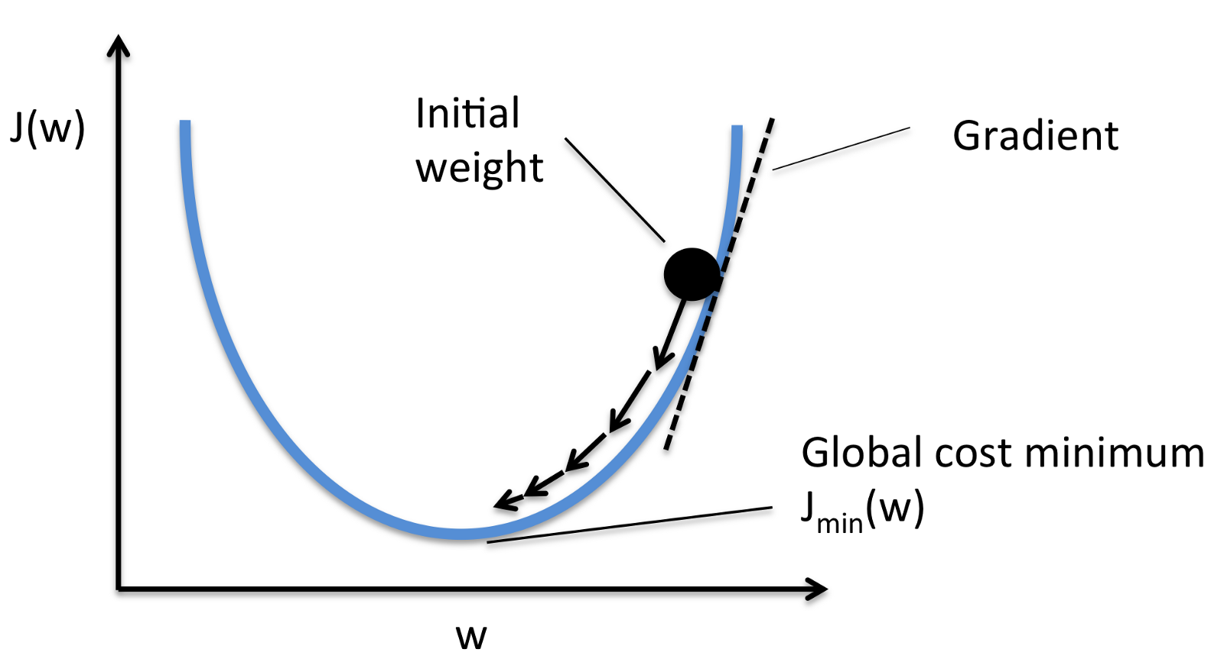
Gradient Descent

Slide 26
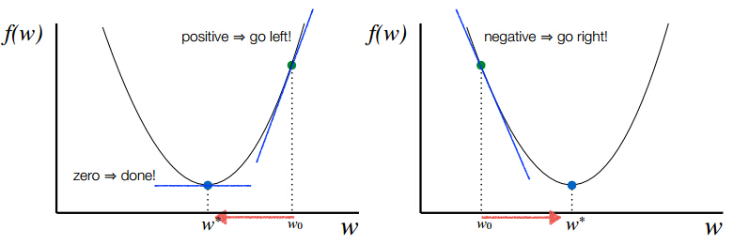
Gradient Descent

Slide 27
Gradient Descent
If f is function to be minimized (cost function), Gradient descent changes the parameters of learning model iteratively as below:
GD simply measures the change in all weights with regard to the change in error. We can also think of a gradient as the slope of a function.

Slide 28
Gradient Descent
The higher the gradient, the steeper the slope and the faster a model can learn. But if the slope is zero, the model stops learning. Said it more mathematically, a gradient is a partial derivative with respect to its inputs.
How big the steps are that Gradient Descent takes into the direction of the local minimum are determined by the learning rate.

Slide 29
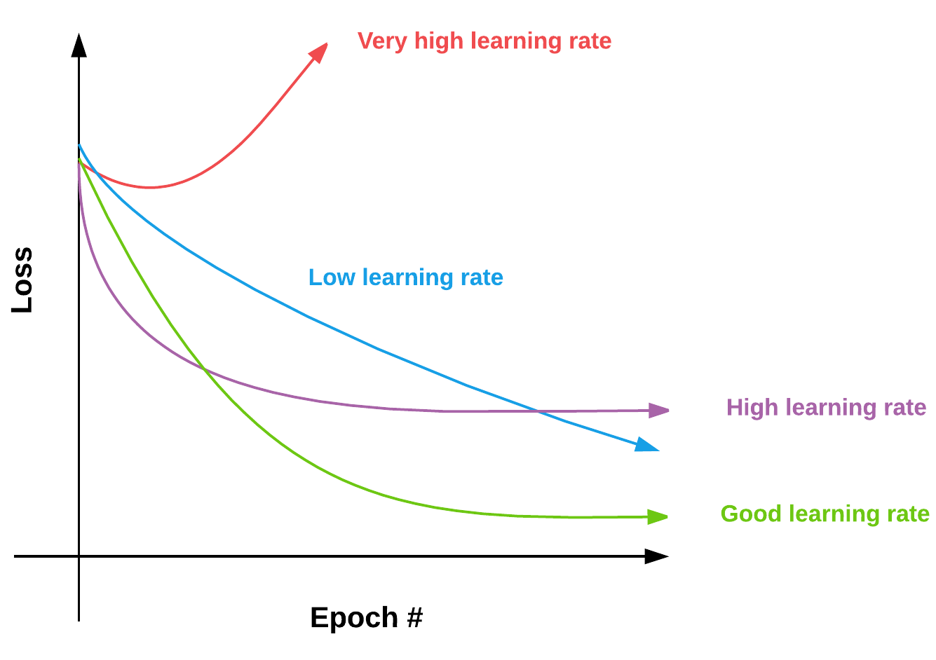
Gradient Descent
With a high learning rate we can cover more ground each step, but we risk overshooting the lowest point. A low learning rate is more precise, but calculating the gradient is time-consuming, so it will take us a very long time to get to the bottom.

Slide 30
Batch Perceptron Algorithm
When training set is large, taking each training example one by one and updating perceptron weights is time consuming tasks.
In such case batch perceptron algorithm is suitable. The main concept behind batch perceptron algorithm is: “Process training examples in batches. Size of batch should be defined on the basis of size of training set. Commonly used batch size are 16, 32, 64,128, etc. ”
Then, update weights for (n+1)^{th} step by taking sum of all misclassifications in the batch of training example.

Slide 31
Batch Perceptron Algorithm
For the training examples that are incorrectly classified by the algorithm:
Therefore, to minimize cost function for Perceptron, we can write:

Slide 32
Batch Perceptron Algorithm
Differentiate above cost function w.r.t. w to get gradient vector.
In the steepest descent method, the adjustment to the weight vector w at each time step of the algorithm is applied in a direction opposite to the gradient vector.
Thus, weight update rule for batch perceptron algorithm can be written as

Slide 33
Multi-Layer Feedforward NN
A multilayer feed-forward network consists of an input layer, one or more hidden layers, and an output layer. Computations take place in the hidden and output layers only.
The input signal propagates through the network in a forward direction layer-by-layer. Such neural networks are called multilayer perceptrons (MLPs).
They have been successfully applied to many difficult and diverse problems.
Multilayer perceptrons are typically trained using so-called error backpropagation algorithm. This is a supervised error-correction learning algorithm.

Slide 34
Multi-Layer Feedforward NN
Properties of MLPs
Each neuron has a smooth (differentiable everywhere) nonlinear activation function. This is usually a sigmoidal nonlinearity defined by the logistic function
Note: Nonlinearities are important: otherwise the network could be reduced to a linear single-layer perceptron.
The network contains hidden layer(s), enabling learning complicated tasks and mappings.
The network has a high connectivity.

Slide 35
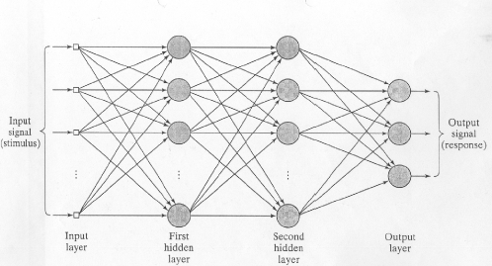
Multi-Layer Feedforward NN
An architectural graph of a fully connected multilayer perceptron with two hidden layers and an output layer is given below.

Slide 36
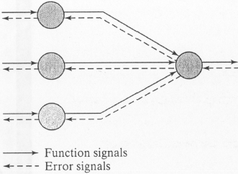
Multi-Layer Feedforward NN
Two kinds of signals appear in the MLP networks: Function Signal and Error Signal.
Function Signals: Function signals are the Input signals that propagates in forward direction through the network and produces output signals in the last phase.
Error Signals: These are the signals originate at output neurons, and propagate layer by layer in backward direction through the network.

Slide 37
Multi-Layer Feedforward NN
Each hidden or output neuron performs two computations:
The computation of the function signal appearing at its output. This is a nonlinear function of the input signal and synaptic weights of that neuron.
The computation of an estimate of the gradient vector, needed in the backward pass.

Slide 38
Batch and Online Learning
Batch Learning
In the batch method of supervised learning, adjustments to the synaptic weights of the multilayer perceptron are updated after the presentation of all the N examples in the training sample T that constitute one epoch of training.
In other words, the cost function for batch learning is defined by the average error energy and adjustments to the synaptic weights of the multilayer perceptron are made on an epoch-by-epoch basis.

Slide 39
Batch and Online Learning
Batch Learning
With the method of gradient descent used to perform the training, the advantages of batch learning include the following:
Accurate estimation of the gradient vector, thereby guaranteeing, convergence of the method of steepest descent to a local minima for non-convex surfaces and at global minima for convex surface;
parallelization of the learning process.

Slide 40
Batch and Online Learning
Batch Learning
For large datasets, batch learning is computationally intractable because it is not possible to store entire dataset into memory at once.
Since it updates weights less frequently, it is computationally faster.

Slide 41
Batch and Online Learning
Online Learning
In the on-line method of supervised learning, adjustments to the synaptic weights of the multilayer perceptron are performed on an example-by-example basis. The cost function to be minimized is therefore the total instantaneous error energy for one training example.
Due to noise gradient descent calculated for each of the training examples, online learning jumps here and there which makes it difficult to converge in global minima. Due to this behavior of online learning, it is also called stochastic method.

Slide 42
Batch and Online Learning
Online Learning
Besides this, parallelization of online learning method is not possible.
Since it updates weights example by example basis, it is computationally slower than batch learning. But, it is computationally tractable for the large training set because we do not need to store large dataset into memory at once.

Slide 43
Batch and Online Learning
Trade-off Between Batch and Online Learning
If we look above discussion, we can conclude that Batch learning is better approach. But, it is computationally intractable for large datasets.
On the other hand, online learning is computationally tractable for large datasets but it is difficult to converge in global minim.
Thus, the better approach is to use mini-batch learning approach, where entire dataset is divided into batches of size 16 or 32 or 64 or 128 etc., on the basis of need and synaptic weights of the multilayer perceptron are updated after the presentation of all the N examples in a mini-batch.

Slide 44
Backpropagation Algorithm
A popular method for the training of multilayer perceptrons is the back-propagation algorithm. The training proceeds in two phases:
Forward Phase: In this phase, the synaptic weights of the network are fixed and the input signal is propagated through the network, layer by layer, until it reaches the output. Thus, in this phase, changes are confined to the activation potentials and outputs of the neurons in the network.

Slide 45
Backpropagation Algorithm
Backward Phase: In this phase, an error signal is produced by comparing the output of the network with a desired response. The resulting error signal is propagated in backward direction through the network, again layer by layer. In this second phase, successive adjustments are made to the synaptic weights of the network

Slide 46
Backpropagation Algorithm
The error signal at the output of neuron j at iteration n is given by
The total instantaneous error energy E(n) for all the neurons in the output layer is therefore

Slide 47
Backpropagation Algorithm
Let N be the total number of training vectors (examples). Then the average squared error is:
Consider the neuron j as given in next slide. The local field v_{j}(n) and output y_{j}(n) of neuron j is given by:

Slide 48
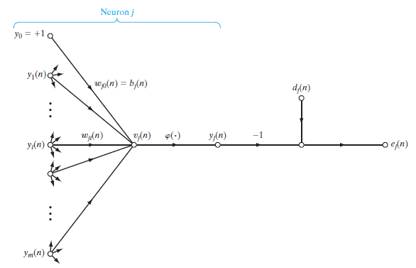
Backpropagation Algorithm

Slide 49
Backpropagation Algorithm
The correction made to the weight is proportional to the partial derivative of instantaneous error
Using the chain rule of calculus, this gradient can be expressed as follows:
We can get following partial derivatives

Slide 50
Backpropagation Algorithm
Putting all partial derivatives in equation 1, we get
The correction applied to the weight is defined by

Slide 51
Backpropagation Algorithm
Using equation (2), equation (3) can be written as
This can be written as
The error term in equation 4 and 5 depends upon location of neuron in the MLP. There can be two possible scenarios.

Slide 52
Backpropagation Algorithm
Case I: Neuron j is output layer neuron
The desired response d_{j}(n) for the neuron j is directly available. Computation of the error e_{j}(n) is straightforward in this case. We can use equation 4 or 5 to calculate weight update term.
Case II: Neuron j is hidden layer neuron
There is no desired response available for neuron j. The error signal for a hidden neuron must be determined recursively in terms of the error signals of all neurons connected to it as below:

Slide 53
Backpropagation Algorithm
Algorithm
Initialize all weights and biases in network
While terminating condition is not satisfied
for each training tuple X in D
for each input layer unit j: y_{j} = x_{j}; // output of an input unit is its actual input value
for each hidden or output layer unit j
compute the net input of unit j with respect to the previous
layer,
compute the output of each unit j

Slide 54
Learning in ANN
Algorithm
for each unit j in the output layer
for each unit j in the hidden layers, from the last to the first hidden layer
for each weight w_{ji} in network
//Weight Update

Slide 55
Backpropagation Algorithm
Backpropagation algorithm needs to compute
to compute . This depends upon choice of activation function.
Case I: Logistic Activation Function
If we consider general sigmoid function, then
Note: Compute Derivatives of Logistic activation function.

Slide 56
Backpropagation Algorithm
Case II: Hyperbolic Tangent Function
If we consider general Tanh function, then
Note: Compute Derivatives of Hyperbolic Function.

Slide 57
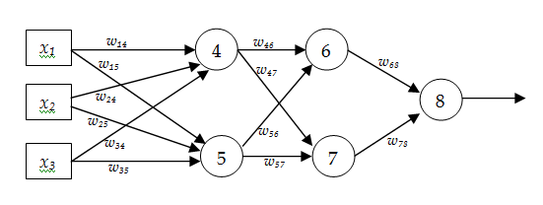
Backpropagation Algorithm
Example
Consider a MLP given below. Let the learning rate be 1. The initial weights of the network are given in the table below. Assume that first training tuple is (1, 0, 1) and its target output is 1. Calculate weight updates by using back-propagation algorithm. Assume .
w₁₄ | w₁₅ | w₂₄ | w₂₅ | w₃₄ | w₃₅ | w₄₆ | w₄₇ | w₅₆ | w₅₇ | w₆₈ | w₇₈
0.6 | 0.4 | 0.2 | -0.3 | 0.7 | -0.6 | 0.4 | 0.7 | 0.1 | 0.8 | 0.2 | 0.5

Slide 58
Backpropagation Algorithm
Solution
Forward Pass
v₄=1*0.6+0*0.2+1*0.7=1.3 y₄=1/1+e^{-1.3}=0.786
v₅=1*0.4+0*(-0.3)+1*(-0.6)=-0.2 y₅=1/1+e^{0.2}=0.45
v₆=0.786*0.4+0.45*0.1=0.36 y₆=1/1+e^{-0.36}=0.59
v₇=0.786*0.7+0.45*0.8=0.91 y₇=1/1+e^{-0.91}=0.71
v₈=0.59*0.2+0.71*0.5=0.47 y₈=1/1+e^{-0.47}=0.61

Slide 59
Backpropagation Algorithm
Solution
Backward Pass

Slide 60
Backpropagation Algorithm
Solution
Update Weights

Slide 61
Backpropagation Algorithm
HW
Consider a MLP given below. Let the learning rate be 1. The initial weights of the network are given in the table below. Assume that first training tuple is (1, 0, 1) and its target output is 1. Calculate weight updates by using back-propagation algorithm. Assume .
w₁₄ | w₁₅ | w₂₄ | w₂₅ | w₃₄ | w₃₅ | w₄₆ | w₄₇ | w₅₆ | w₅₇ | w₆₈ | w₇₈
0.6 | 0.4 | 0.2 | -0.3 | 0.7 | -0.6 | 0.4 | 0.7 | 0.1 | 0.8 | 0.2 | 0.5

Slide 62
XOR Problem
We know that single layer perceptron can be trained to classify patterns that is linearly separable.
However, XOR function is non-linearly separable as shown in the figure given below. Thus, we can not train single layer perceptron for XOR function. This, problem is called XOR Problem.
1
0
x₁
0
1

Slide 63
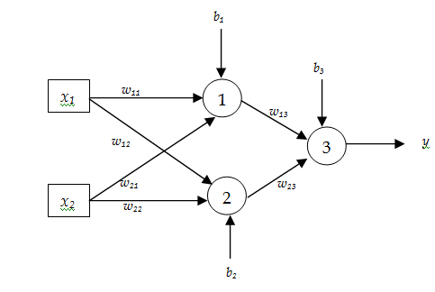
XOR Problem
We need to use multilayer perceptron that contains one hidden layer with two neurons to achieve XOR functionality from it.
Determine the weights of links for above MLP such that MLP functions as XOR. Assume that threshold activation function (as shown above) is used in each of the neuron.

Slide 64
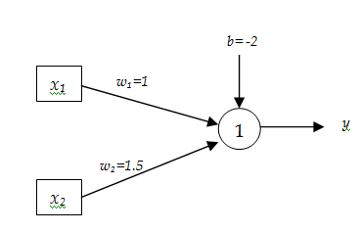
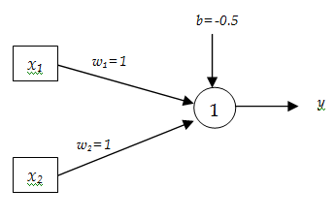
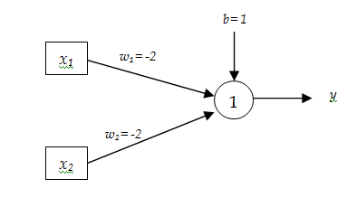
XOR Problem
We can have following realization of AND, OR, and NOR gates using perceptron.
Fig: AND Function
Fig: OR Function
Fig: NOR Function

Slide 65
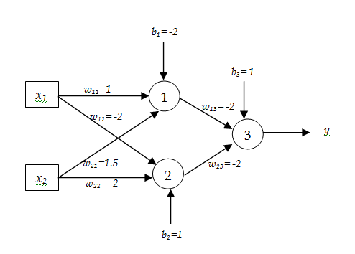
XOR Problem
XOR function can be represented in terms of function of AND and NOR functions as below.
NOR(AND(x₁,x₂),NOR(x₁,x₂))
Thus, Weights of MLP that acts as XOR function can be set as below

Slide 66
XOR Problem
CW
Realize NOT and NAND function using perceptron.
Can we realize XNOR function using perceptron? If yes, realize it using perceptron. Otherwise, realize XNOR function using MLP.

Slide 67
Jacobian and Hessian
The Jacobian is a matrix of all the first-order partial derivatives of a vector-valued function. In the neural network case, it is an N-by-W matrix, where N is the number of entries in our training set and W is the total number of parameters (weights) of our network.
It can be generated by taking the partial derivatives of each output with respect to each weight.
Each row of the Jacobian corresponds to a particular example in the training sample.

Slide 68
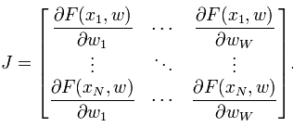
Jacobian and Hessian
While it is a good exercise to compute the gradient of a neural network with respect to a single parameter (e.g., a single weight), in practice this tends to be quite slow. This approach can’t take advantage of vectorization. Thus, for vectorized implementation of backpropagation algorithm , it is necessary to use Jacobian.

Slide 69
Jacobian and Hessian
Hessian of a cost function is square matrix whose elements are second order partial derivative of the cost function with respect to each weight in the MLP.

Slide 70
Learning Rate Annealing
One of the key hyper parameters to set in order to train a neural network is the learning rate.
If learning rate is set too low, training will progress very slowly as we are making very tiny updates to the weights in our network.
However, if learning rate is set too high, it can cause undesirable divergent behavior in our loss function.

Slide 71
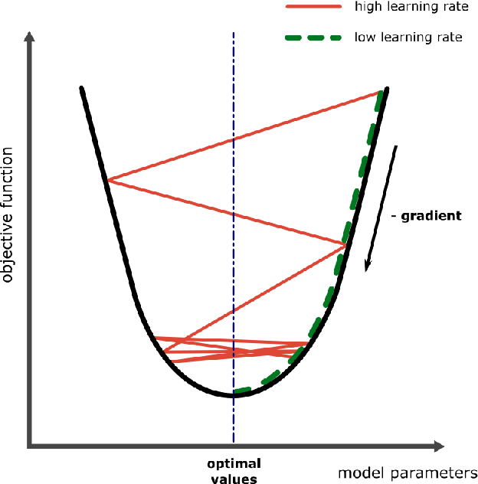
Learning Rate Annealing

Slide 72
Learning Rate Annealing
Learning Rate Annealing
One approach of using learning rate value properly is to start with large value of learning rate and reduce value of the learning rate according to some predefined schedule. This approach is called learning rate annealing.
Three commonly used learning rate annealing techniques or learning rate schedules are:
Time Based Decay
Step Decay
Exponential Decay

Slide 73
Learning Rate Annealing
Time Based Decay
Mathematical formulation of time-based learning rate decay is given below:
Example
Let α₀=0.2 Decay_Rate=1
For Epoch=1 α=0.2/2=0.1
For Epoch=2 α=0.2/3=0.067
For Epoch=3 α=0.2/4=0.05
So on

Slide 74
Learning Rate Annealing
Step Decay
Mathematical formulation of step decay of learning rate is given below. A typical way is to drop the learning rate by half afterv every 10 epochs.
Example
Let α₀=0.2 drop_rate=0.5 epochs_drop=5
For Epoch=5 α=0.2 x 0.5^{5/5}=0.1
For Epoch=10 α= 0.2 x 0.5^{10/5}=0.05
For Epoch=15 α= 0.2 x 0.5^{15/5}=0.025
So on

Slide 75
Learning Rate Annealing
Exponential Decay
Mathematical formulation of exponential decay of learning rate is given below.
Example
Let α₀=0.2 k=0.1
For Epoch=1 α=0.181
For Epoch=2 α=0.164
For Epoch=3 α=0.148
So on

Slide 76
Adaptive Control of Learning Rate
Learning rate annealing techniques reduces learning rate equally for all parameters and applies the same learning rate with all parameters.
However, in many practical situations, we need to change value of different parameters by different extent.
Thus, the better approach is to use the techniques that gives learning rate a chance to adapt.

Slide 77
Adaptive Control of Learning Rate
Adaptive Control of Learning Rate
The main idea behind adaptive learning rate is to use larger learning rate for updating parameters that are modified with small scale in past and use smaller learning rate for updating parameters that are modified with large scale in the past.
Four commonly used learning rate adaptation techniques are: Momentum, Adagrad, Adadelta, RMSProp, and Adam.

Slide 78
Adaptive Control of Learning Rate
Momentum
Momentum uses the past gradients to smooth out the parameter update.
It computes an exponentially weighted average of gradients and then uses this gradient to update the weights.

Slide 79
Adaptive Control of Learning Rate
Adagrad
In Adagrad, the variable v, called cache, keeps track of sum of the squared gradients, which in turn is used to normalize the parameter update.

Slide 80
Adaptive Control of Learning Rate
Adagrad
The effect of above equations is that Weights receiving high gradients will have their effective learning rate reduced. On the other hand, weights receiving small gradients will have their effective learning rate increased.

Slide 81
Adaptive Control of Learning Rate
Adadelta
Adadelta is an extension of Adagrad that seeks to reduce its aggressive, monotonically decreasing learning rate. Instead of accumulating all past squared gradients, Adadelta restricts the window of accumulated past gradients to some fixed size W.

Slide 82
Adaptive Control of Learning Rate
RMSProp
Adagrad decays the learning rate very aggressively (as the denominator grows). As a result, after a while, parameters receiving larger gradients will start receiving very small updates because of the decayed learning rate.
To avoid this why not decay the denominator and prevent its rapid growth.
RMSProp stands for root mean squared propagation and avoids monotonically increasing denominator of Adagrad.

Slide 83
Adaptive Control of Learning Rate
RMSProp
The central idea of RMSProp is keep the moving average of the squared gradients for each weight. And then divide the learning rate by root mean square of the squared gradients.

Slide 84
Adaptive Control of Learning Rate
Adam
Adam update can be considered as RMSprop with momentum. In place of raw and noisy gradient vector dw, weighted average of gradients are used.
Weighted average of gradients
Weighted average of squared gradients

Slide 85
Adaptive Control of Learning Rate
Adam
Bias Correction
Finally, update weights as below:

Slide 86
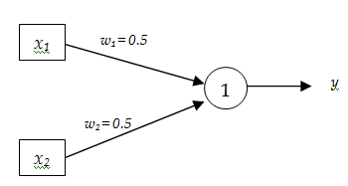
Adaptive Control of Learning Rate
Example
Consider following simple ANN with logistic activation function. Assume that . Calculate weight updates for the given training Sample using (1) Momentum (2) Adagrad (3) RMSProp and (4) Adam
x₁ | x₂ | t
1 | 0.6 | 0.8
0.5 | 0.5 | 0.6
0.2 | 0.8 | 0.3

Slide 87
Adaptive Control of Learning Rate
Solution
For Adagrad
For Training example:
(1,0.6,0.8)

Slide 88
Adaptive Control of Learning Rate
Solution
For Adagrad
For Training example:
(0.5,0.5,0.6)

Slide 89
Adaptive Control of Learning Rate
Solution
For Adagrad
For Training example:
(0.2,0.8,0.3)

Slide 90
Adaptive Control of Learning Rate
Solution
For RMSProp
For Training
example:(1,0.6,0.8)

Slide 91
Adaptive Control of Learning Rate
Solution
For RMSProp
For Training
example:(0.5,0.5,0.6)

Slide 92
Adaptive Control of Learning Rate
Solution
For RMSProp
For Training
example:(0.2,0.8,0.3)

Slide 93
Adaptive Control of Learning Rate
Solution
For Momentum and Adam
??????---try yourself

Slide 94
Adaptive Control of Learning Rate
Example
Consider following simple ANN with logistic activation function. Assume that . Calculate weight updates for the given training Sample using (1) Momentum (2) Adagrad (3) RMSProp and (4) Adam.
Note: Use bias correction feature in each case
x₁ | x₂ | t
1 | 0.6 | 0.8
0.5 | 0.5 | 0.6
0.2 | 0.8 | 0.3

Slide 95
Cross-Validation
In machine learning, datasets are divided into three sets: Training Set, Validation Set, and Test Set. Split ratio of dataset into three sets is not fix. It depends upon size of the dataset. If we have very large dataset split ratio can be 98:1:1. Otherwise, we can opt for split ratio 80:10:10 or 70:15:15 so on.
Training set is used to train neural network and update weights on the basis of error. Validation set is used to compute prediction error using weights resulted from training. If the error is higher than a user-defined threshold then the whole training-validation epoch is repeated.

Slide 96
Cross-Validation
The testing set is then used to measure the performance of the network. This is the data that was never used throughout the training and validation phase.
Cross-validation is a re-sampling procedure used to evaluate machine learning models on a limited data sample.
k-Fold Cross-Validation (Muti-Fold Cross-Validation) is widely used for cross validation. If we choose k=10, it becomes 10-fold cross validation.

Slide 97
Cross-Validation
In this approach, the original sample is randomly partitioned into k equal sized subsamples. Out of the k subsamples, a single subsample is used as the testing set, and the remaining k − 1 subsamples are used as training+validation data.
The cross-validation process is then repeated k times, with each of the k subsamples used exactly once as the testing data. The k results can then be averaged to produce a single estimation.

Slide 98
Cross-Validation
The advantage of this method is that all observations are used for both training and testing, and each observation is used for testing exactly once. 10-fold cross-validation is commonly used, but in general k remains an unfixed parameter.
For example, setting k = 2 results in 2-fold cross-validation. In 2-fold cross-validation, we randomly shuffle the dataset into two sets d₀ and d₁, so that both sets are equal size. We then train on d₀ and test on d₁, followed by training on d₁ and testing on d₀.

Slide 99
Cross-Validation
When k = n (the number of observations), k-fold cross-validation is equivalent to leave-one-out cross-validation. In this case, n - 1 examples are used to train the model, and the model is validated by testing it on the example that is left out. This approach is suitable when we have small number of training example.
To make the cross-validation procedure concrete, let’s look at a worked example. Imagine we have a data sample with 6 observations:
{(1,3),(2,5),(3,7),(4,9),(5,11),(6,13)}
Let k=3. That means we will shuffle the data and then split the data into 3 groups.

Slide 100
Cross-Validation
Let k=3. That means we will shuffle the data and then split the data into 3 groups.
Fold 1= {(1,3),(5,11)}
Fold 2= {(6,13),(3,7)}
Fold 3= {(2,5),(4,9)}
Three models are trained and evaluated with each fold given a chance to be the held out test set. For example:
Model 1: Trained on Fold 1 + Fold 2, Tested on Fold 3
Model 2: Trained on Fold 2 + Fold 3, Tested on Fold 1
Model 3: Trained on Fold 1 + Fold 3, Tested on Fold 2

Slide 101
Cross-Validation
In typical cross-validation, results of multiple runs of model-testing are averaged together. In contrast, the holdout method, involves a single run.
It should be used with caution because without such averaging of multiple runs, one may achieve highly misleading results. Predictive accuracy will tend to be unstable since it will not be smoothed out by multiple iterations.

Slide 102
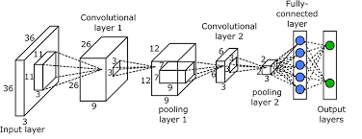
Convolutional Neural Network(CNN)
CNN is a type of multilayer neural network specially designed for detecting, recognizing, and classifying images.
Every CNN consist following three types of layers: Convolution Layer, Pooling layer, and Fully-connected Layer. Typical architecture of CNN is shown below:

Slide 103
Convolutional Neural Network(CNN)
Convolution Layer
Convolution layer extracts features from an input image. It preserves the relationship between pixels by learning image features using small squares of input data. It is a mathematical operation that takes two inputs such as image matrix and a filter or kernel and produces an image with convolved features.
Consider a 5 x 5 image whose pixel values are 0, 1 and filter matrix 3 x 3 as shown in below.
The matrix formed by sliding the filter over the image and computing the dot product is called Feature Map or Convolved Feature.

Slide 104
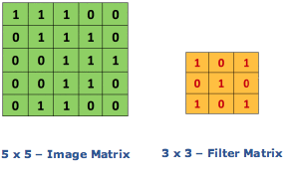
Convolutional Neural Network(CNN)
Convolution Layer
Convolution of an image with different filters can perform operations such as edge detection, blur and sharpen by applying filters.
4 | 3 | 4
2 | 4 | 3
2 | 3 | 4
Feature Map

Slide 105
Convolutional Neural Network(CNN)
Pooling Layer
Spatial Pooling or simply Pooling reduces the dimensionality of each feature map but retains the most important information.
It is also called sub-sampling or down-sampling. Spatial Pooling can be of different types: Max, Average, Sum etc.
In case of Max Pooling, we define a spatial neighborhood (for example, a 3×3 window) and take the largest element from the rectified feature map within that window.

Slide 106
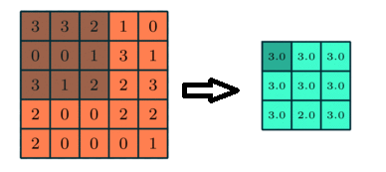
Convolutional Neural Network(CNN)
Pooling Layer
Instead of taking the largest element we could also take the average (Average Pooling) or sum of all elements in that window. In practice, Max Pooling has been shown to work better.
Figure: 3x3 Max Pooling over 5x5 convolved feature

Slide 107
Convolutional Neural Network(CNN)
Fully Connected Layer
The Fully Connected layer is a traditional Multi Layer Perceptron that uses a softmax activation function in the output layer. The term “Fully Connected” implies that every neuron in the previous layer is connected to every neuron on the next layer.
The output from the Convolutional and Pooling layers represent high-level features of the input image. The purpose of the Fully Connected layer is to use these features for classifying the input image into various classes based on the training dataset.

Slide 108
Convolutional Neural Network(CNN)
Fully Connected Layer
The Softmax function takes a vector of arbitrary real-valued scores and squashes it to a vector of values between zero and one that sum to one.
The Fully-Connected layer learns non-linear function in output produced by Convolutional and Pooling Layer.
We should flatten the image into a column vector. The flattened output is fed to the Fully Connected Layer and backpropagation can be applied to train the network.

Slide 109
Convolutional Neural Network(CNN)
Example
Consider following 6x6 image and 3x3 filter as below. Compute feature map and pooled feature map using 2x2 window. Use Max pooling.
255 | 200 | 120 | 89 | 0 | 180
210 | 230 | 170 | 165 | 87 | 76
49 | 120 | 115 | 125 | 165 | 140
20 | 35 | 32 | 42 | 37 | 78
55 | 65 | 75 | 45 | 35 | 69
190 | 180 | 160 | 150 | 155 | 165
1 | 1 | 0
0 | 1 | 0
0 | 1 | 1

Slide 110
Fast Learning Method: Newton’s Method
One of the main problem with gradient descent is slow convergence.
Newton's method is a second-order algorithm because it makes use of the Hessian matrix.
This method's objective is to find better training directions by using the second derivatives of the loss function.
Second order Taylor series expansion of the cost function around point w(n) is given as below.

Slide 111
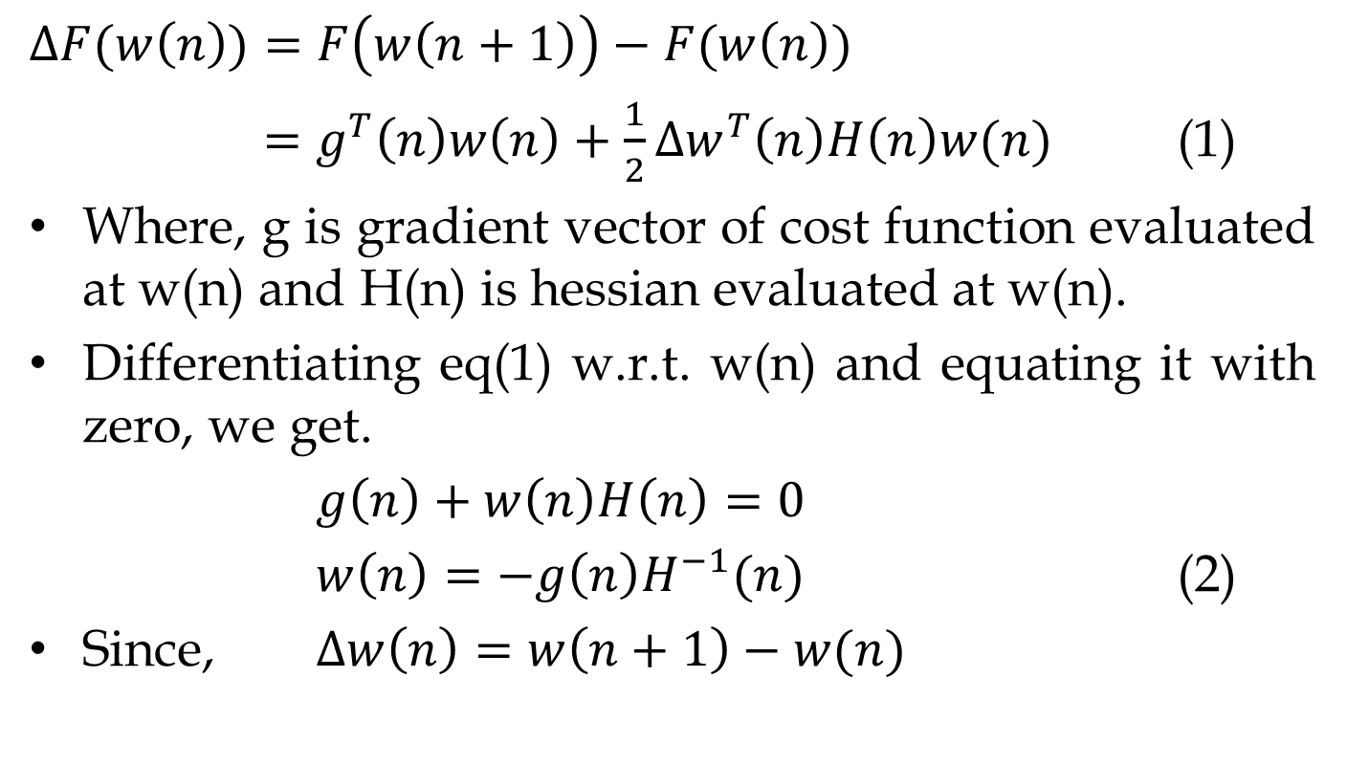
Fast Learning Method: Newton’s Method
$$∆F(w\left(n\right))=F\left(w\left(n+1\right)\right)−F(w\left(n\right))$$
$=g^{T}\left(n\right)w\left(n\right)+\frac{1}{2}∆w^{T}\left(n\right)H\left(n\right)w(n)$ (1)
Where, g is gradient vector of cost function evaluated at w(n) and H(n) is hessian evaluated at w(n).
Differentiating eq(1) w.r.t. w(n) and equating it with zero, we get.
$g\left(n\right)+w\left(n\right)H\left(n\right)=0$
$w\left(n\right)=−g\left(n\right)H^{−1}(n)$ (2)
Since, $∆w\left(n\right)=w\left(n+1\right)−w(n)$

Slide 112
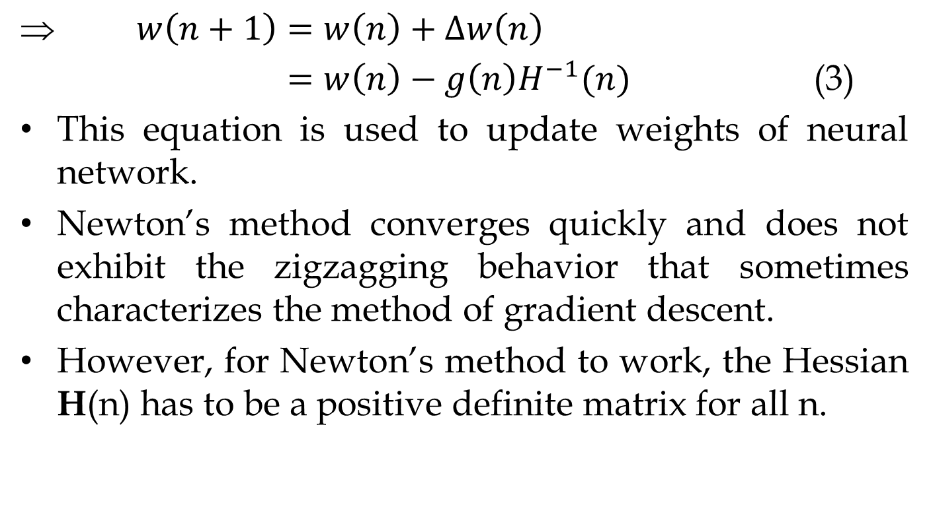
Fast Learning Method: Newton’s Method
$w\left(n+1\right)=w\left(n\right)+∆w\left(n\right)$
$=w\left(n\right)−g\left(n\right)H^{−1}(n)$ (3)
This equation is used to update weights of neural network.
Newton’s method converges quickly and does not exhibit the zigzagging behavior that sometimes characterizes the method of gradient descent.
However, for Newton’s method to work, the Hessian H(n) has to be a positive definite matrix for all n.

Slide 113
Fast Learning Method: Newton’s Method
Unfortunately, in general, there is no guarantee that H(n) is positive definite at every iteration of the algorithm.
In any event, a major limitation of Newton’s method is its computational complexity.

Slide 114
Fast Learning Method: Conjugate Gradient
The Backpropagation algorithm adjusts the weights in the steepest descent direction (negative of the gradient).
This is the direction in which the cost function decreases most rapidly.
Although the function decreases most rapidly along the negative of the gradient, this does not necessarily produce the fastest convergence due to zigzag nature of convergence path.

Slide 115
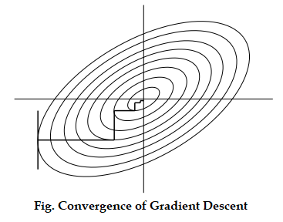
Fast Learning Method: Conjugate Gradient
If gradient descent finds minimum in each search direction, successive search directions will be orthogonal to each other. This is the reason behind zig-zag convergence path of the gradient descent.

Slide 116
Fast Learning Method: Conjugate Gradient
In Backpropagation, a learning rate is used to determine the length of the weight update (step size).
However, In the conjugate gradient algorithms, the step size is adjusted at each iteration. A search is made along the conjugate gradient direction to determine the step size, which minimizes the cost function along that line.

Slide 117
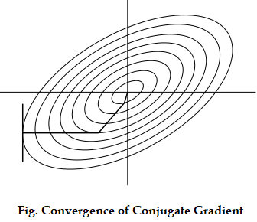
Fast Learning Method: Conjugate Gradient
The concept behind conjugate gradient descent is that since each step is taking the same general direction, the combination of search directions should minimize the zig-zag nature of convergence path and capture the general trend towards the minimum.

Slide 118
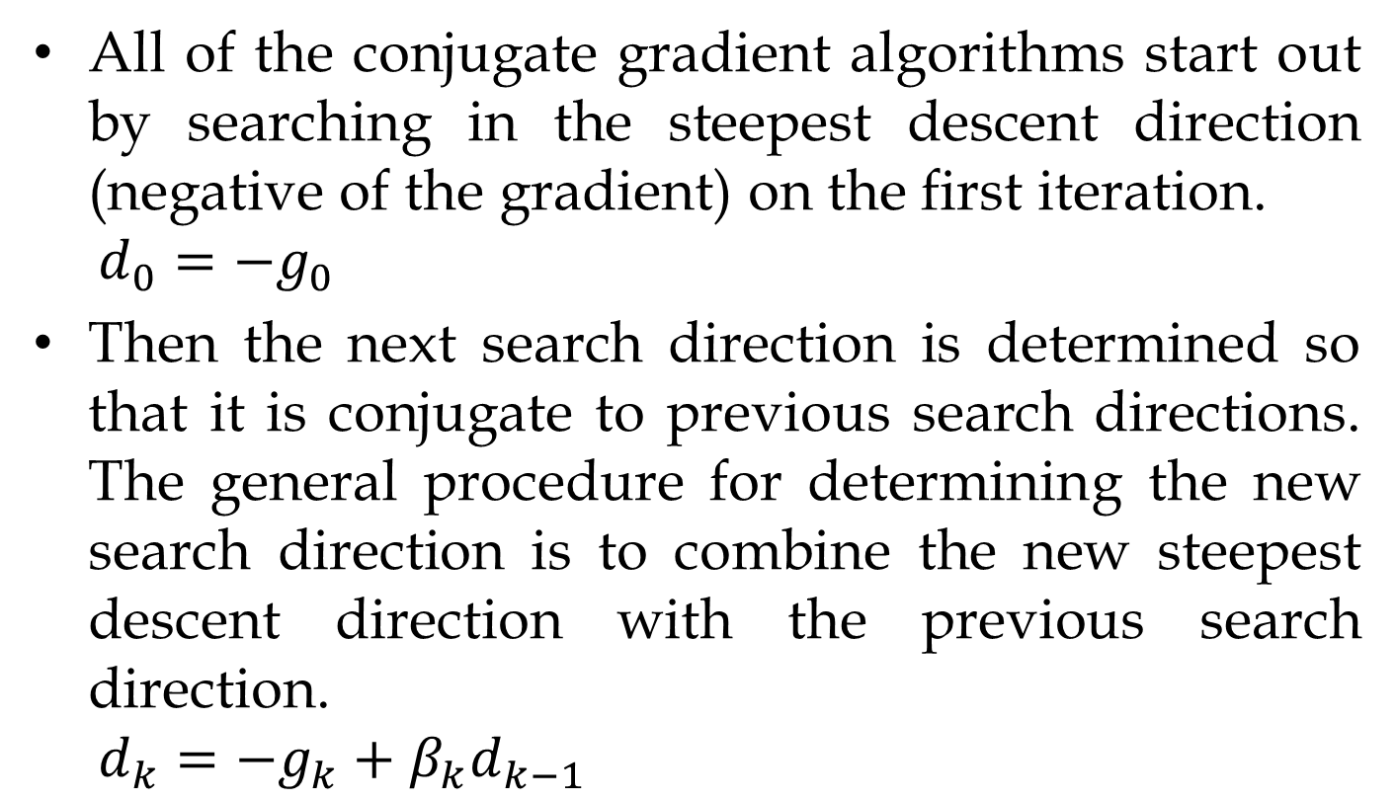
Fast Learning Method: Conjugate Gradient
All of the conjugate gradient algorithms start out by searching in the steepest descent direction (negative of the gradient) on the first iteration.
$$d_{0}=−g_{0}$$
Then the next search direction is determined so that it is conjugate to previous search directions. The general procedure for determining the new search direction is to combine the new steepest descent direction with the previous search direction.
$$d_{k}=−g_{k}+β_{k}d_{k−1}$$

Slide 119
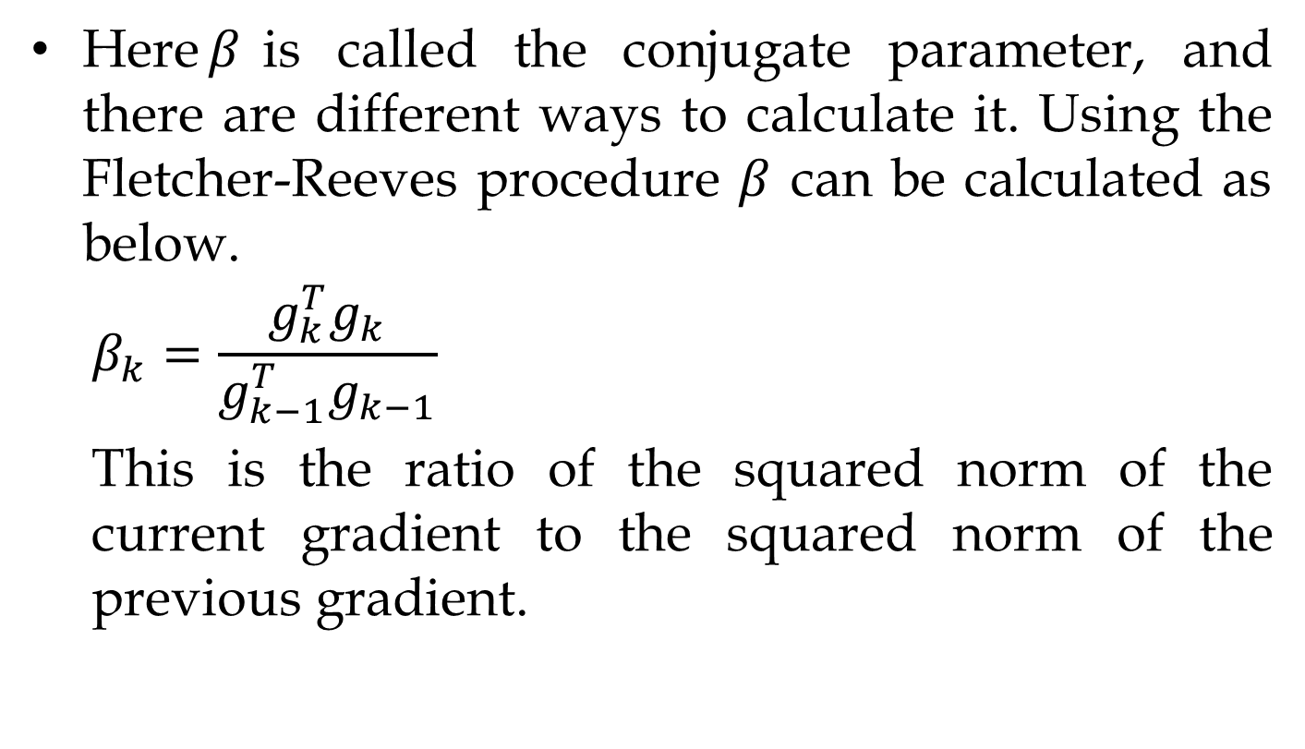
Fast Learning Method: Conjugate Gradient
Here$β$is called the conjugate parameter, and there are different ways to calculate it. Using the Fletcher-Reeves procedure $β$ can be calculated as below.
$$β_{k}=\frac{g_{k}^{T}g_{k}}{g_{k−1}^{T}g_{k−1}}$$
This is the ratio of the squared norm of the current gradient to the squared norm of the previous gradient.

Slide 120
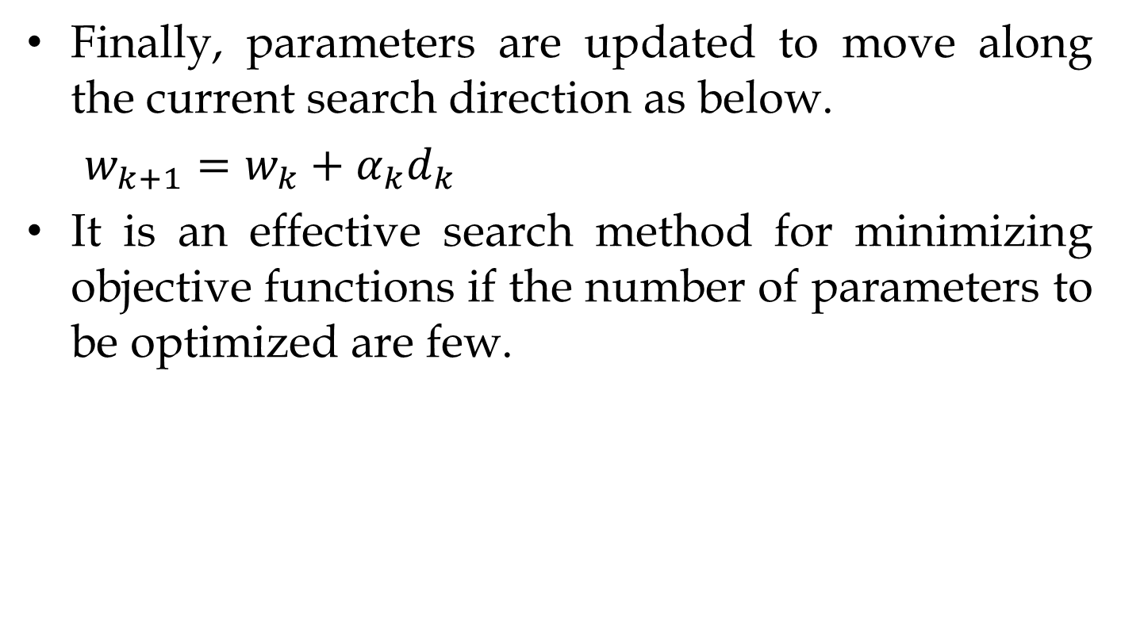
Fast Learning Method: Conjugate Gradient
Finally, parameters are updated to move along the current search direction as below.
$w_{k+1}=w_{k}+α_{k}d_{k}$
It is an effective search method for minimizing objective functions if the number of parameters to be optimized are few.

Slide 121
Auto associative Neural Network
This is a fully-connected neural network in which the input training vector and the output target vectors are the same.
The weights are determined so that the network stores a set of patterns.
A stored vector can be retrieved from a distorted or noisy vector if the input is similar to it.
This network can be trained using Hebbian learning rule or Heb’s rule.

Slide 122
Auto associative Neural Network
The rule is based on the assumption that if two neighbor neurons activated and deactivated at the same time. Then the weight connecting these neurons should increase. For neurons operating in the opposite phase, the weight between them should decrease. If there is no signal correlation, the weight should not change.
This assumption can be described by using following formula.

Slide 123

Auto associative Neural Network
Activation function for auto associative neural network is:
$y_{j}=1 if y_{in}>c$,
$y_{j}=x_{j} if y_{in}=c$ and
$$y_{j}=−1 if y_{in}<c$$

Slide 124
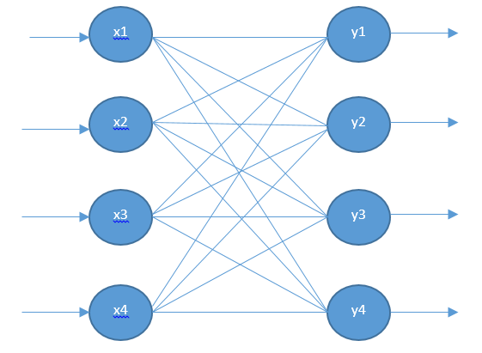
Auto associative Neural Network
Architecture of AANN

Slide 125
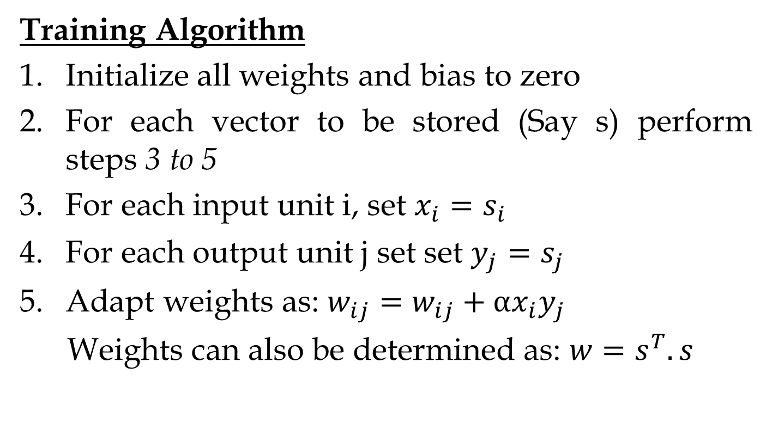
Auto associative Neural Network
Training Algorithm
Initialize all weights and bias to zero
For each vector to be stored (Say s) perform steps 3 to 5
For each input unit i, set $x_{i}=s_{i}$
For each output unit j set set $y_{j}=s_{j}$
Adapt weights as: $w_{ij}=w_{ij}+αx_{i}y_{j}$
Weights can also be determined as: $w=s^{T}.s$

Slide 126
Auto associative Neural Network
Example
Use the Heb’s rule to store the pattern [1, 1,-1,-1] in an AANN. Find weight matrix and Test the input vector [-1,1,-1,-1].
Solution
Here, pattern to be stored(s)=[1,1,-1,-1]
Now, w=

Slide 127

Auto associative Neural Network
Now,
Test input=$[−1 1 −1 −1]$
The calculate $y_{in}=x.w=[2 2 −2 −2]$
Finally compute $y=[1 1 −1 −1]$

Slide 128
Bayesian Neural Network
Taking a probabilistic approach to neural network allows to account for uncertainty, so that models can assign less levels of confidence to incorrect predictions.
Sources of uncertainty can be found in the data, due to measurement error or noise in the labels, or the model, due to insufficient data availability for the model to learn effectively.

Slide 129
Bayesian Neural Network
The idea behind Bayesian neural network is that, instead of learning specific weight (and bias) values in the neural network, the Bayesian approach learns weight distributions - from which we can sample to produce an output for a given input - to encode weight uncertainty.

Slide 130
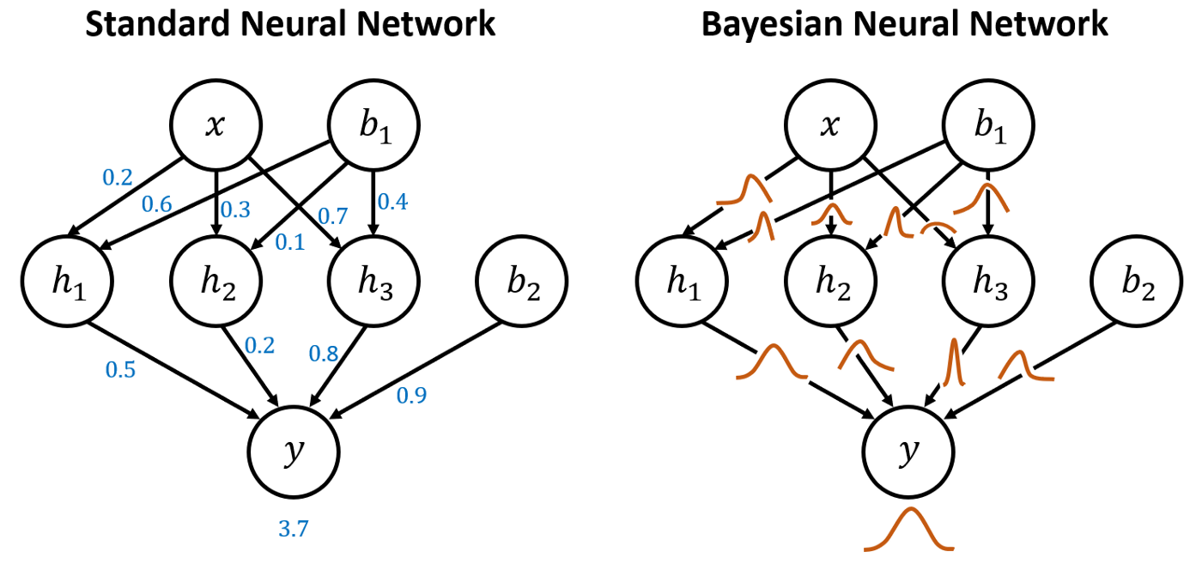
Bayesian Neural Network

